Slide 1
School of thoughts
Anoosha rehan, lecturer, fast nuces cfd

Slide 2
Transition phase of psychology
From philosophy to science

Slide 3


Many psychologists when agreed on one discipline, presented a school of thought. In late 19th and 20th century, the following schools emerged:
Structuralism
Functionalism
Behaviorism
Psychoanalytic
Cognitive
Gestalt
Humanistic
Biological
Social
Evolutionary
33

Slide 4
Cognitive perspective
Cognition means the mental process involved in processing, storing and using information.
Cognitive psychology focuses on the process of thinking or the processing of information.
Because our ability to remember plays an integral part in the processing of information, a cognitive psychologist is likely to have a lot to say about the storage and retrieval of memories.
A cognitive psychologist might ask why processing seems different when we are trying to remember names and dates while taking a history test compared to remembering how to ride a bicycle.

Slide 5
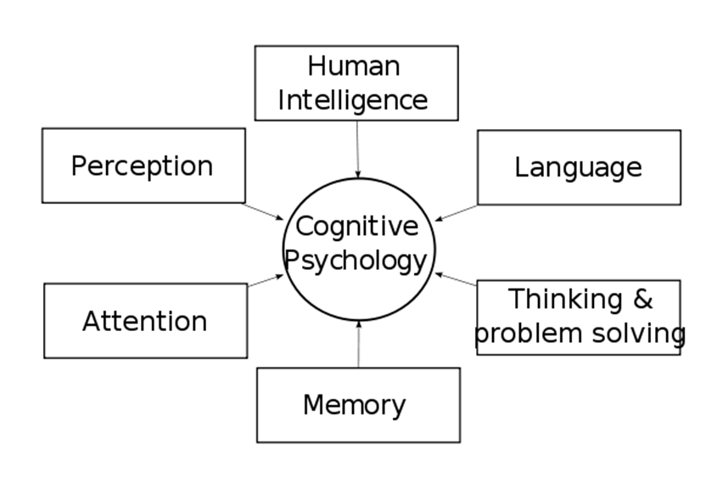
Cognitive perspective: Jean Piaget, Noam Chomsky
What processes lead to the frustrating experience of having something on the “tip of your tongue,” in which you remember the first letter or a part of a word you’re trying to retrieve, but not the whole thing? What strategies can we use to make our memories more efficient?
One of the most influential theories of this school of thought was the stages of cognitive development theory proposed by Jean Piaget: Theory of cognitive development.

Slide 6
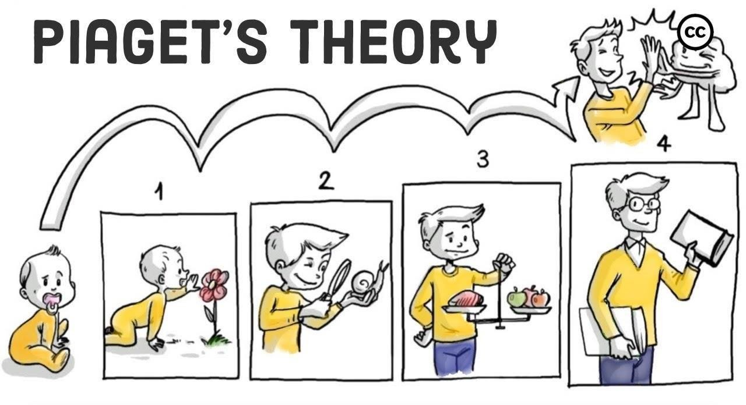
Cognitive perspective
Piaget's (1936) theory of cognitive development explains how a child constructs a mental model of the world. He disagreed with the idea that intelligence was a fixed trait, and regarded cognitive development as a process which occurs due to biological maturation and interaction with the environment.

Slide 7
Cognitive perspective
Piaget's Stages of Cognitive Development:
Sensorimotor Stage (Birth to 2 Years): In this stage, babies learn about the world using their senses, like touching and seeing. A big milestone here is understanding that things still exist even when you can't see them.
Preoperational Stage (2 to 7 Years): As you get a bit older, you start using words and symbols to think. However, your thinking is a bit selfish at this stage, and you might believe everyone thinks like you do. You might also get fooled by appearances, like thinking a tall glass has more water than a short, wide one.
Concrete Operational Stage (7 to 11 Years): Now, you become better at thinking logically about real objects and events. You can do math, understand the idea of conservation (like knowing the water amount is the same in both glasses), and start seeing things from other people's points of view.
Formal Operational Stage (11 Years and Up): When you reach adolescence and beyond, you become capable of more abstract thinking. You can think about "what if" scenarios, plan for the future, and understand complex concepts.

Slide 8
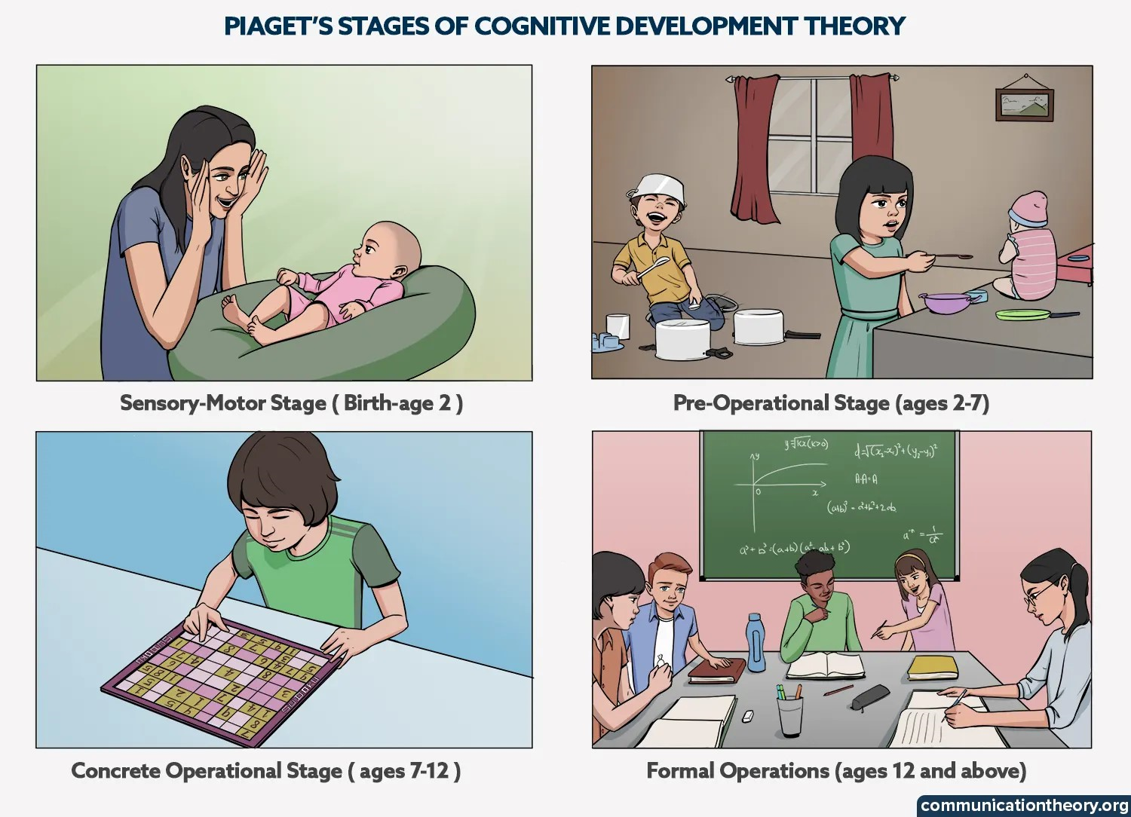

Slide 9
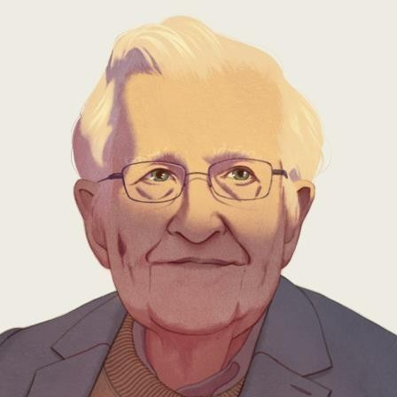
Cognitive perspective
Noam Chomsky
Each child, says Chomsky, is born with brain structures that make it relatively easy for the child to learn the rules of language. Chomsky argues that children cannot learn these rules if they have to rely solely on principles of association (such as frequency or contiguity) and on reinforcement.

Slide 10
Gestalt Perspective: Wertheimer, Köhler & Koffka
Developed by several German psychologists, this school focuses on how context effects perception; believing that our perception is the whole that gives meaning to the parts.
This school of thought, unlike behaviorists, believes that learning is active and purposeful.

Slide 11
Gestalt Perspective
Instead of breaking down thoughts and behavior to their smallest elements, the gestalt psychologists believed that you must look at the whole of experience. According to the Gestalt thinkers, the whole is greater than the sum of its parts e.g. still picture perceived as a whole presents that beauty as a combination of art and color which is not possible to be perceived as parts separately.

Slide 12
Gestalt Perspective
Gestalt Principles:
Phi phenomenon: The illusion of movement created by presenting visual stimuli in succession (how cartoons were made initially). Even though the individual frames or objects are stationary, our brains perceive them as moving smoothly from one point to another.
Figure and ground: A way of organizing visual perception; the figure is the focus which is being looked at and the ground is the background against which it stands.
Proximity (closeness): Things that are near one another seem to belong together.
Similarity: elements that share similar visual characteristics, such as shape, size, color, or orientation, are grouped together in our perception. This similarity creates a sense of unity.
Continuity: Tendency to follow in whatever direction they’ve been led. people tend to perceive continuous and smooth patterns rather than disjointed and abrupt ones. When lines or curves intersect, we perceive them as continuous rather than as separate parts.
Simplicity: Organizing forms in the simple way possible.
Closure: Mentally adding on to the missing pieces in order to complete a familiar figure.

Slide 13
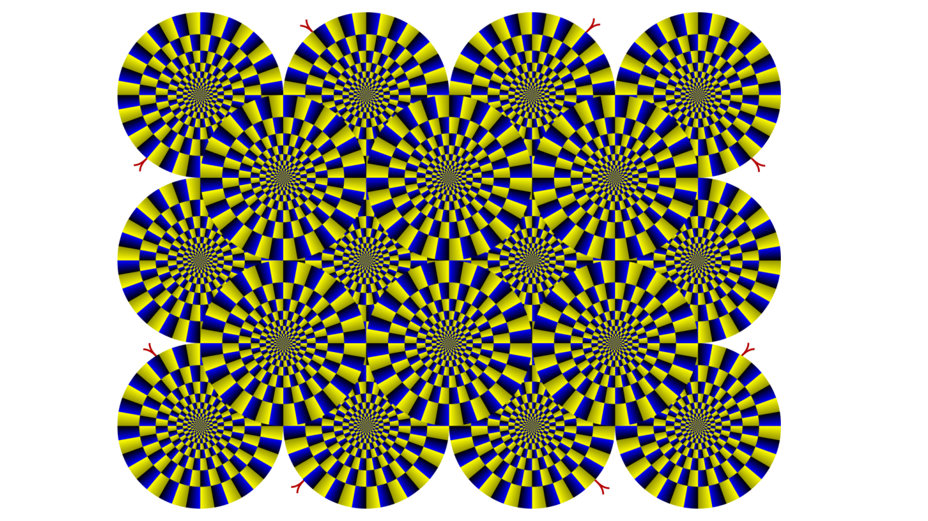

Phi phenomenon

Slide 14
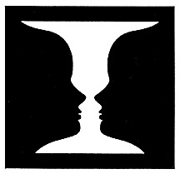
Figure and ground

Slide 15

Figure and ground

Slide 16

proximity

Slide 17
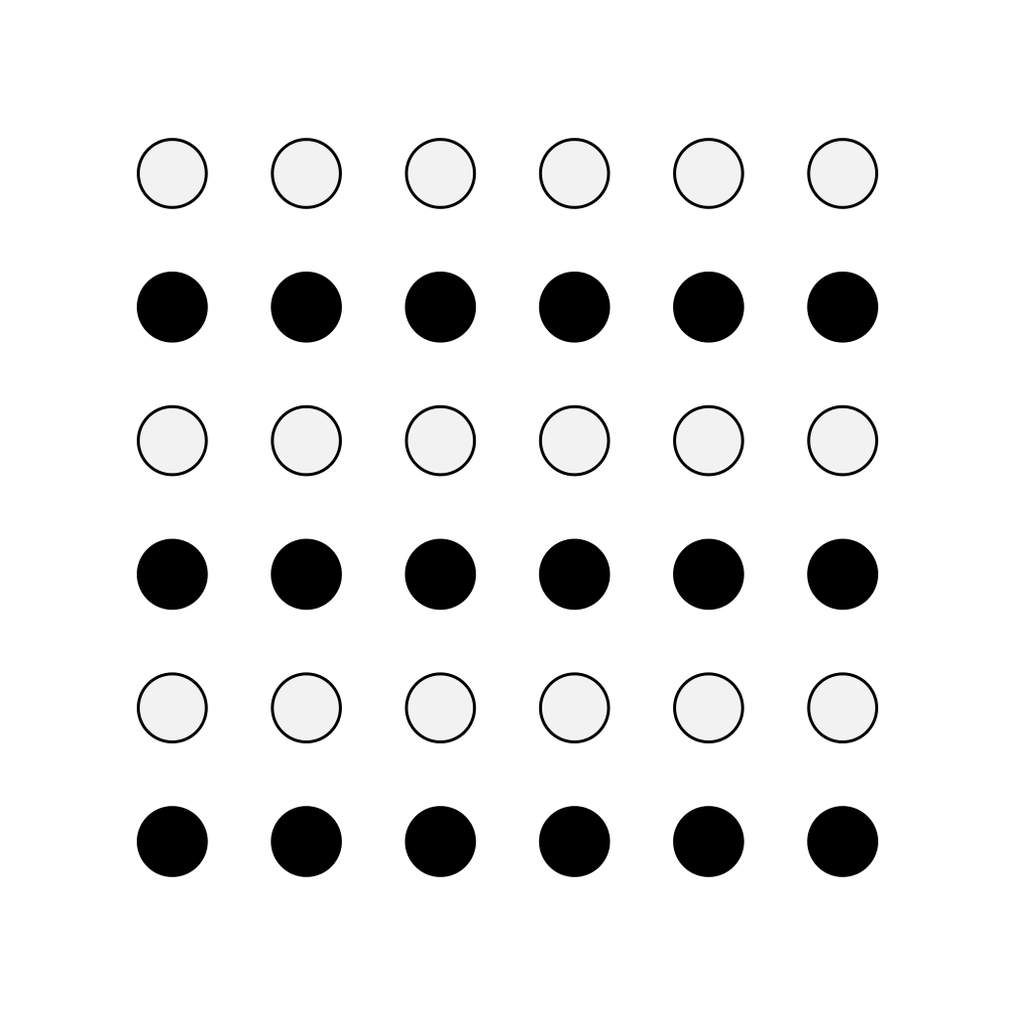
similarity

Slide 18

continuity

Slide 19

simplicity

Slide 20

closure

Slide 21
Humanistic Perspective
‘Humanism is a theoretical orientation that emphasizes the unique qualities of humans, especially their freedom and their potential for personal growth’.
Beginning in the1950s, opposition to behaviorism and psychoanalytic theory led to the emergence of new school of thought called “humanism” because both theories suggested that people are not masters of their own destinies. However, humanistic psychology focuses on free will.

Slide 22
Humanistic Perspective: carl rogers
" An assumption unusual in psychology today is that the subjective human being has an important value which is basic; that no matter how he may be labeled and evaluated he is a human person first of all, and most deeply. "
- Carl Rogers, 1962

Slide 23
Humanistic Perspective: carl rogers
He is best known for developing the psychotherapy method called Client-Centered Therapy or Person-Centered Therapy. The people who came to him with psychological problems, he helped them to realize that they can make choices and decide in determining their future.
For psychotherapy to be successful, Rogers suggested, it was imperative for the therapist to provide unconditional positive regard to the client. This means that the therapist accepts the client as they are and allows them to express both positive and negative feelings without judgment. He also believed that people with a stable sense of self tend to have greater confidence and cope more effectively with life's challenges.

Slide 24
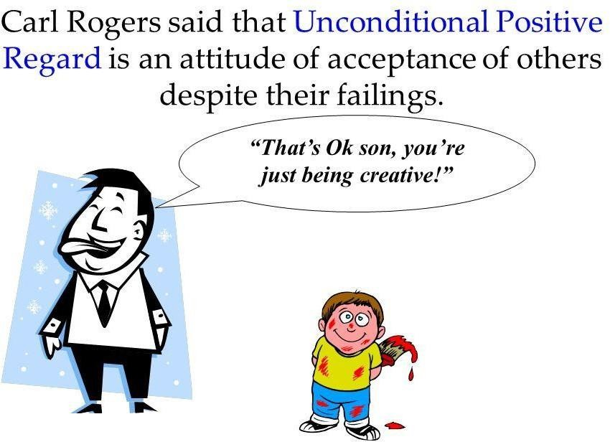

Slide 25
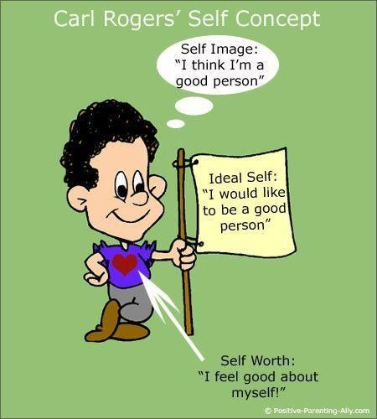

Slide 26
Humanistic Perspective
For Rogers, people who follow the path laid out by their feelings will lead productive, healthy lives. They will experience congruence, or similarity, between their real selves and their ideal selves. Congruence is most likely to occur in response to unconditional positive regard, or a nonjudgmental appreciation for a person’s true nature. Being treated judgmentally makes people act in ways that are incongruent or inconsistent with their ideal selves, which might lead to disordered behaviors.

Slide 27
Real Self: | Ideal Self: | Congruence: | Incongruence:
The real self refers to the person's genuine and authentic self, including their true feelings, thoughts, desires, and experiences. | The ideal self represents the person's aspirations, goals, and the image of who they would like to become. | Congruence occurs when an individual's real self aligns closely with their ideal self. In other words, there is a high degree of consistency between how a person perceives themselves (real self) and their aspirations (ideal self). | Incongruence arises when there is a significant discrepancy between the real self and the ideal self.
It represents who the individual truly is, including their unique qualities, values, and emotions. | It reflects the individual's vision of their best or ideal self, often shaped by societal and cultural influences, personal values, and goals. | Congruence leads to a sense of authenticity, self-acceptance, and psychological well-being. | Incongruence can result from societal pressures, unrealistic expectations, or a lack of self-acceptance.
In an ideal situation, the real self is congruent with the ideal self, meaning that one's self-concept aligns closely with their genuine experiences and feelings. | In a healthy and congruent individual, there is a reasonable alignment between the real self and the ideal self. However, some discrepancy is normal and can serve as motivation for personal growth. | It allows individuals to openly and honestly express their thoughts and emotions, without feeling the need to hide or deny them. | It often leads to inner conflict, anxiety, and emotional distress because individuals may feel compelled to hide or deny their true selves to align with their ideal self.

Slide 28
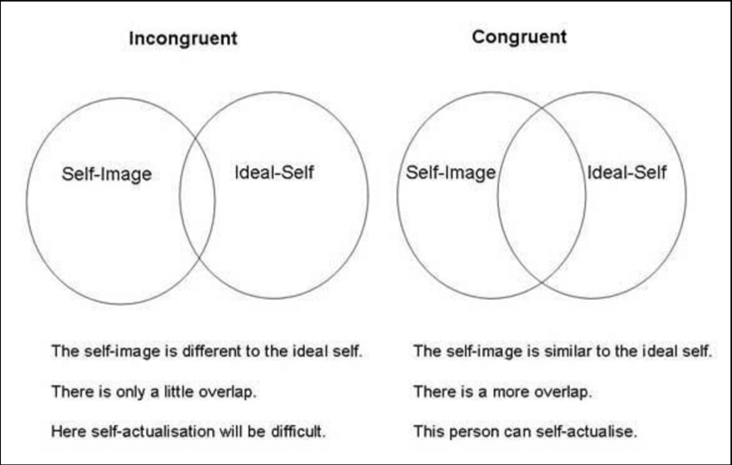

Slide 29
Example:
Imagine a person named Sarah:
Real Self (Authentic Self): Sarah's real self includes her actual qualities, emotions, and experiences. She's naturally introverted, enjoys quiet evenings with a few close friends, and has a passion for art. She values authenticity and meaningful relationships.
Ideal Self (Aspirational Self): Sarah's ideal self is her vision of who she would like to be. She aspires to be more outgoing, attend large social gatherings regularly, and become a successful artist with a strong online presence. She believes that she should be more extroverted to achieve these goals.
Now, let's consider the congruence and incongruence:
Congruence: In areas where Sarah's real self aligns with her ideal self, there is congruence. For instance, her passion for art aligns with her aspiration to be a successful artist. In this aspect, she feels authentic and satisfied with her pursuits.
Incongruence: However, there's incongruence in areas where her real self differs significantly from her ideal self. For instance, Sarah's introverted nature clashes with her aspiration to be more extroverted and attend large social gatherings regularly. This incongruence may lead to inner conflict, anxiety, and feelings of inadequacy.

Slide 30
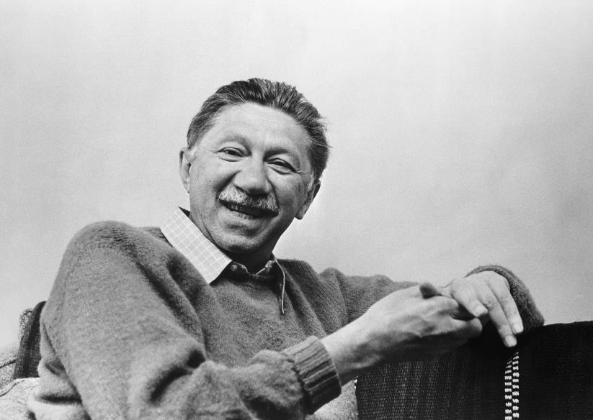
Humanistic Perspective
Abraham Maslow
Abraham Maslow was an American psychologist who developed a hierarchy of needs to explain human motivation. Needs lower down in the hierarchy must be satisfied before individuals can attend to needs higher up. Also called “theory of human motivation”

Slide 31
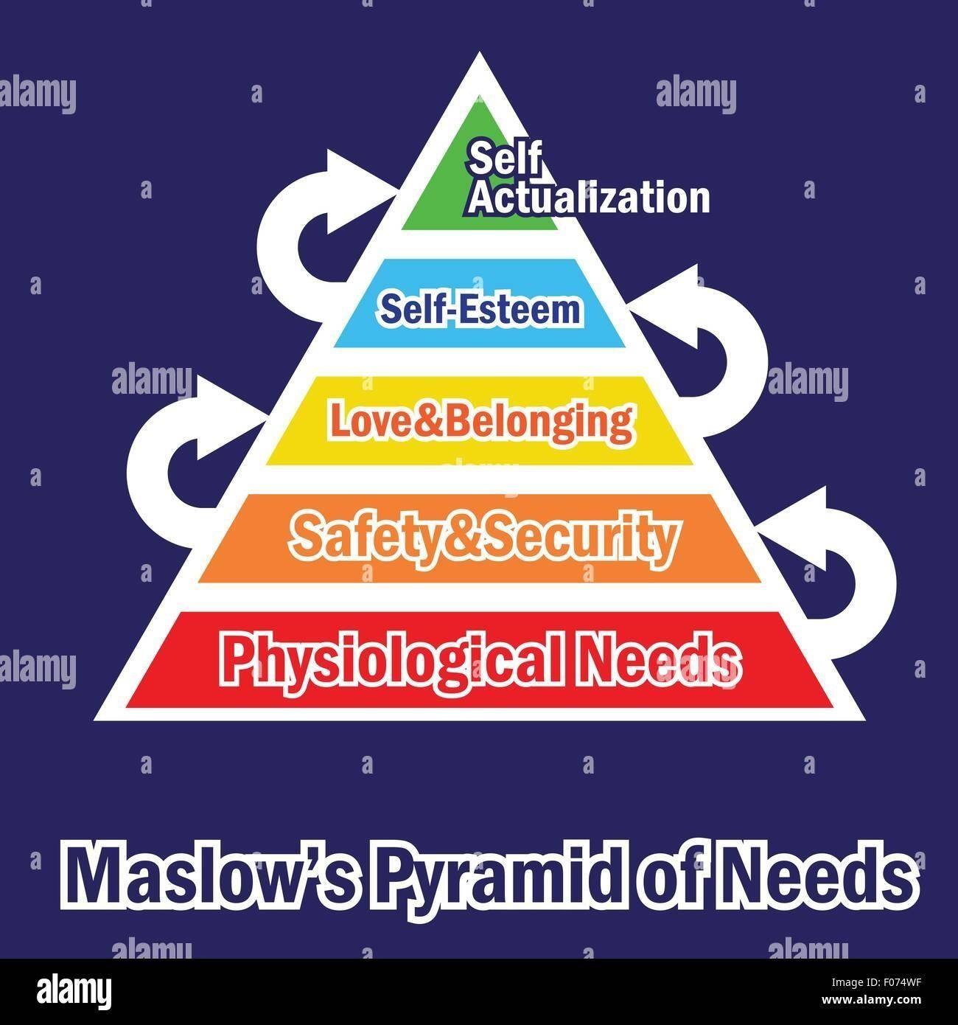

Slide 32
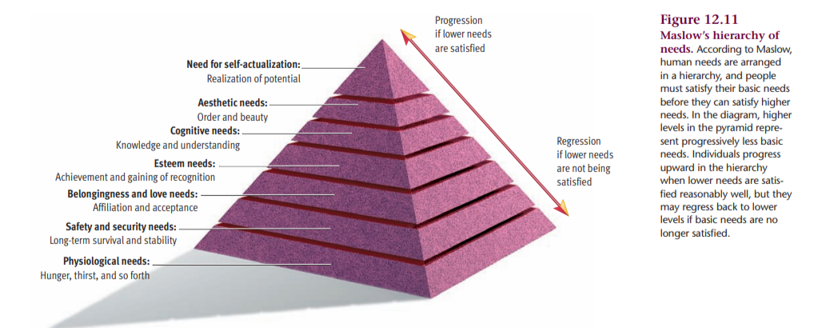

Slide 33
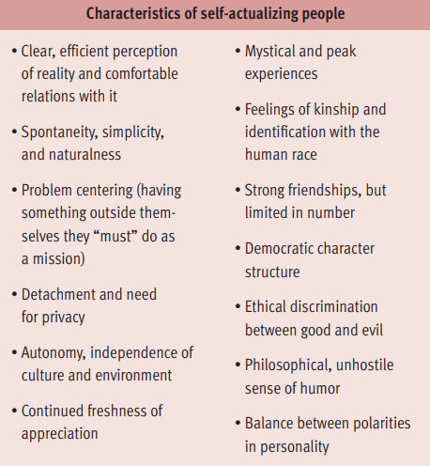

Slide 34
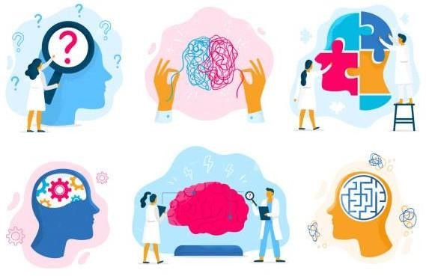
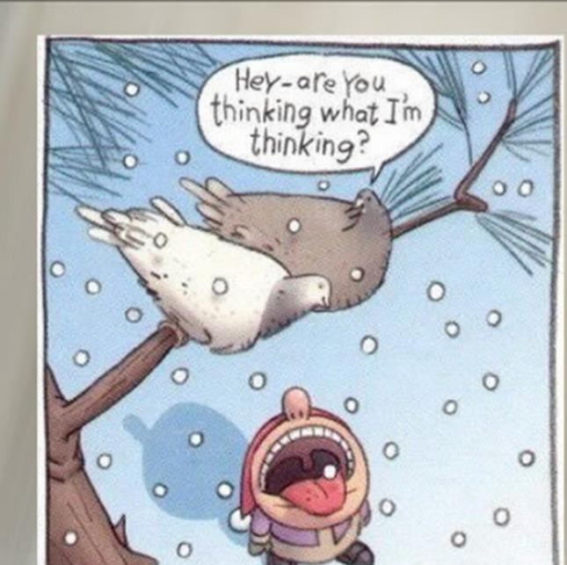
Biological Perspective: Charles Darwin
Perspective that attributes human and animal behavior to biological events occurring in the body, such as genetic influences, hormones, and the activity of the nervous system.

Slide 35
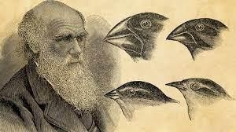
Biological Perspective: Charles Darwin
Charles Darwin first introduced the idea that evolution and genetics play a role in human behavior.
Natural selection influences whether certain behavior patterns are passed down to future generations. Behaviors that aid in survival are more likely to be passed down while those that prove dangerous are less likely to be inherited.

Slide 36
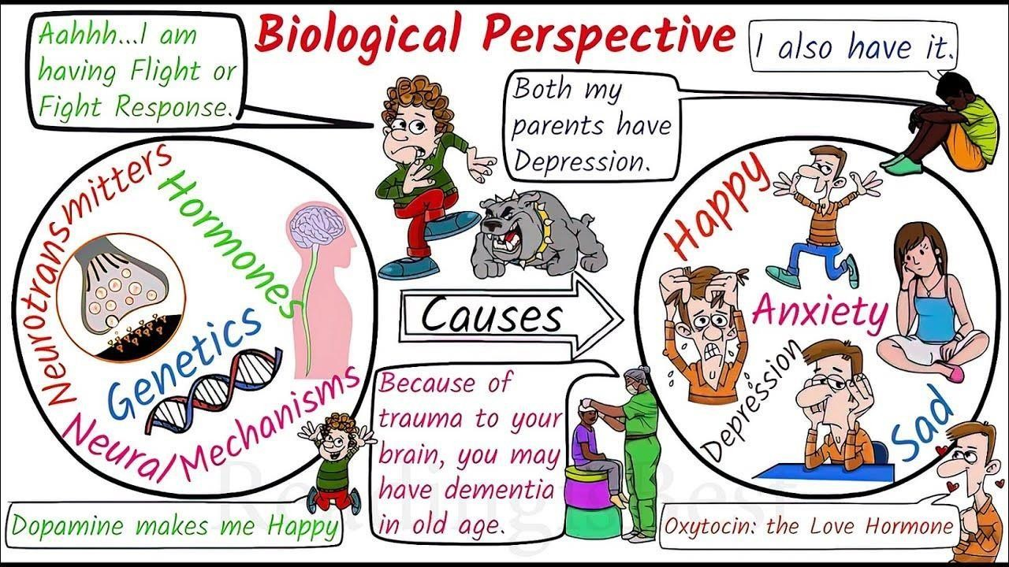

Slide 37
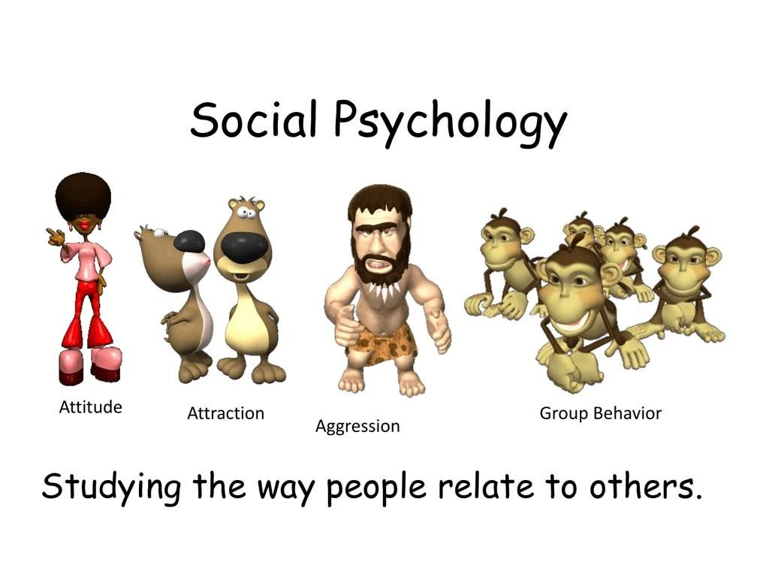
Social Perspective: Solomon Asch
Social psychology is the scientific study of how people think about, influence, and relate to one another. How the individual mind works in the actual presence of others.

Slide 38
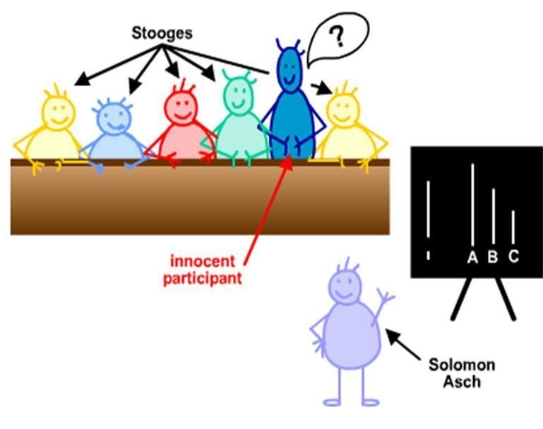
Social Perspective
In Asch's experiments, participants were presented with a simple task where they had to judge the length of lines. When other group members purposefully gave incorrect answers, many participants conformed to the group's incorrect responses, even when it was clear that the group was wrong. This demonstrated the power of social pressure to influence individual behavior.
The results revealed that when other people picked the wrong line, participants were likely to conform and give the same answers as the rest of the group.

Slide 39
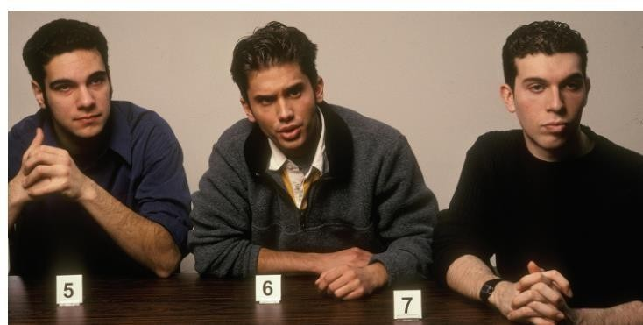
Social Perspective
Social-psychologists explore the effects of the social environment on our individual behavior. In this example, the man in the middle is deciding whether to conform with the other two men in a simple judgment of line length.

Slide 40
Evolutionary perspective
Evolutionary psychology is a branch of psychology that seeks to understand human behavior and cognition by considering how they have evolved over time as adaptations to the challenges and opportunities faced by our ancestors.
Perspective that focuses on the biological bases of universal mental characteristics that all humans share.
It seeks to explain general mental strategies and traits, such as why we lie, why fear of snakes is so common, or why people universally like music and dancing.

Slide 41
Thank you!

